Slide 1
Brandon Amateur Radio Society and The Brandon Regional Hospital

Slide 2
Topics for Discussion
Memorandum of Understanding (MOU)
Hillsborough County EOC and ARES/RACES
Emergency Communications at the Hospital

Slide 3
Memorandum of Understanding
The MOU is a set of guidelines and not a legally binding document.
Mutual agreement to provide a framework of cooperation during emergencies and disasters, as well as other activities.
BARS volunteers are an extension of Hillsborough County ARES/RACES, but will take direction from the Hospital Incident Commander or Emergency Manager.
Volunteers will hold a valid Amateur Radio License.
Volunteers are encouraged to register with ARES/RACES.
BARS will attempt to have one or more volunteers per shift during a Hospital or ARES/RACES activation.

Slide 4
Memorandum of Understanding
Volunteer Emergency Communicators will supplement normal Hospital communication channels and provide voice/written messages to/from the Hospital and the Hillsborough County EOC (and perhaps other hospitals).
Volunteers are not expected to perform duties other than communications.
BARS volunteers will be supported with food and lodging during an emergency and covered under the Hospital’s insurance policies.
BARS agrees to teach and tutor employees of the Hospital who wish to acquire their own Amateur Radio license.

Slide 5
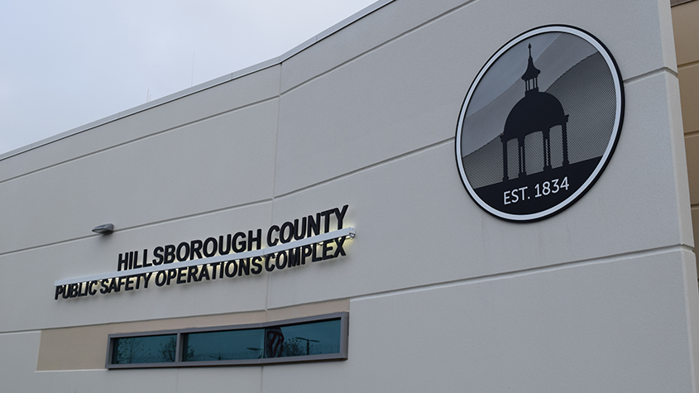
The EOC and ARES/RACES
The Hillsborough County Office of Emergency Management maintains the Emergency Operations Center (EOC) in the Public Safety Operations Complex (PSOC) at 9450 E. Columbus Drive, Tampa, FL.
• The EOC is activated during emergency situations.
Level 3 – Monitoring Phase.
Level 2 – Partial Activation under extended hours.
Level 1 – Full Activation: 24 hour operation.

Slide 6
The EOC and ARES/RACES
The Hillsborough County Office of Emergency Management operates with a Comprehensive Emergency Management Plan (CEMP).

Slide 7
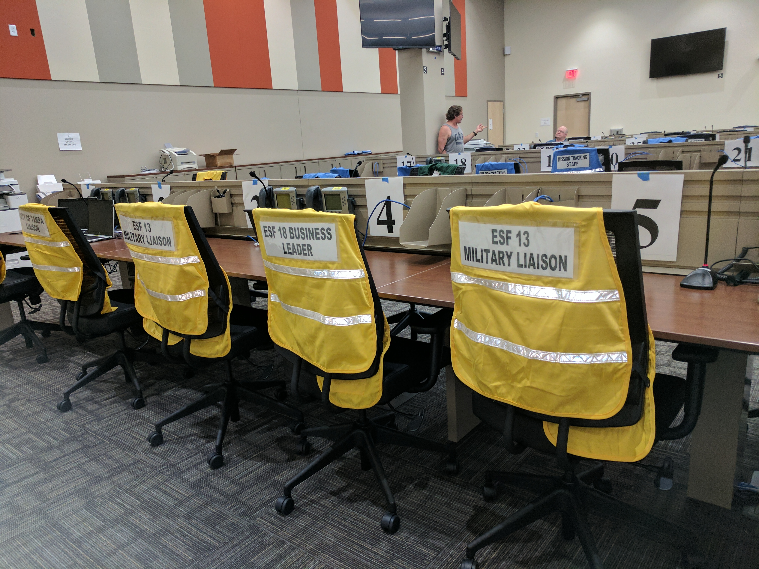
The EOC and ARES/RACES
The EOC uses the Incident Command System (ICS) management framework.
Disaster response is facilitated by using Emergency Support Functions (ESFs): 19 are defined for Hillsborough County.
• Two ESFs are important to hospital operations.
ESF #2 – Communications (Amateur Radio is part of this).
ESF #8 – Health & Medical Services(Hospitals and the Mass Casualty Director are part of this).

Slide 8
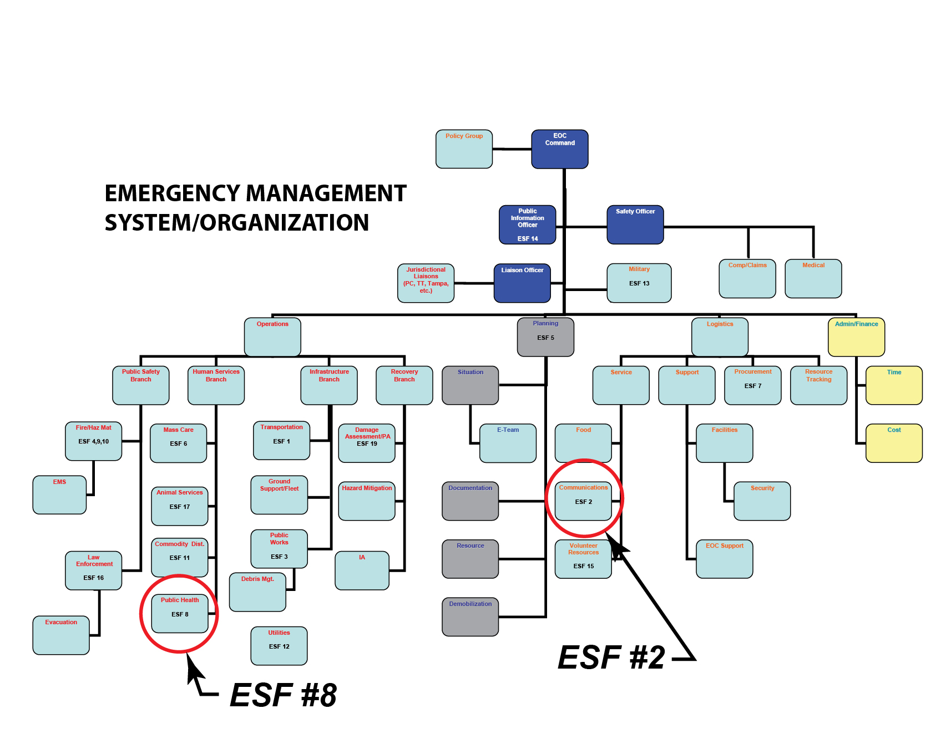
Emergency Management Organization
ESF #2 is in the Logistics Section/Service Branch.
ESF #8 is in the Operations Section/Human Services Branch.
There are 19 ESFs in the organization chart.

Slide 9
The EOC and ARES/RACES
The Amateur Radio Emergency Service® (ARES) consists of licensed amateurs who register and volunteer for communications duty when disaster strikes.
ARES is an arm of the ARRL and has both Regional and County organizations.
We are part of the West Central Florida (WCF) Section of the ARRL and Hillsborough County ARES organizations. Both have Emergency Coordinators.
ARES can be activated before, during and after an emergency.
The Radio Amateur Civil Emergency Service (RACES) is a “standby radio service” provided in the FCC Part 97.407 and relates to “Civil Defense and government agencies.”
RACES is usually activated only “during an emergency,” not before or after.

Slide 10
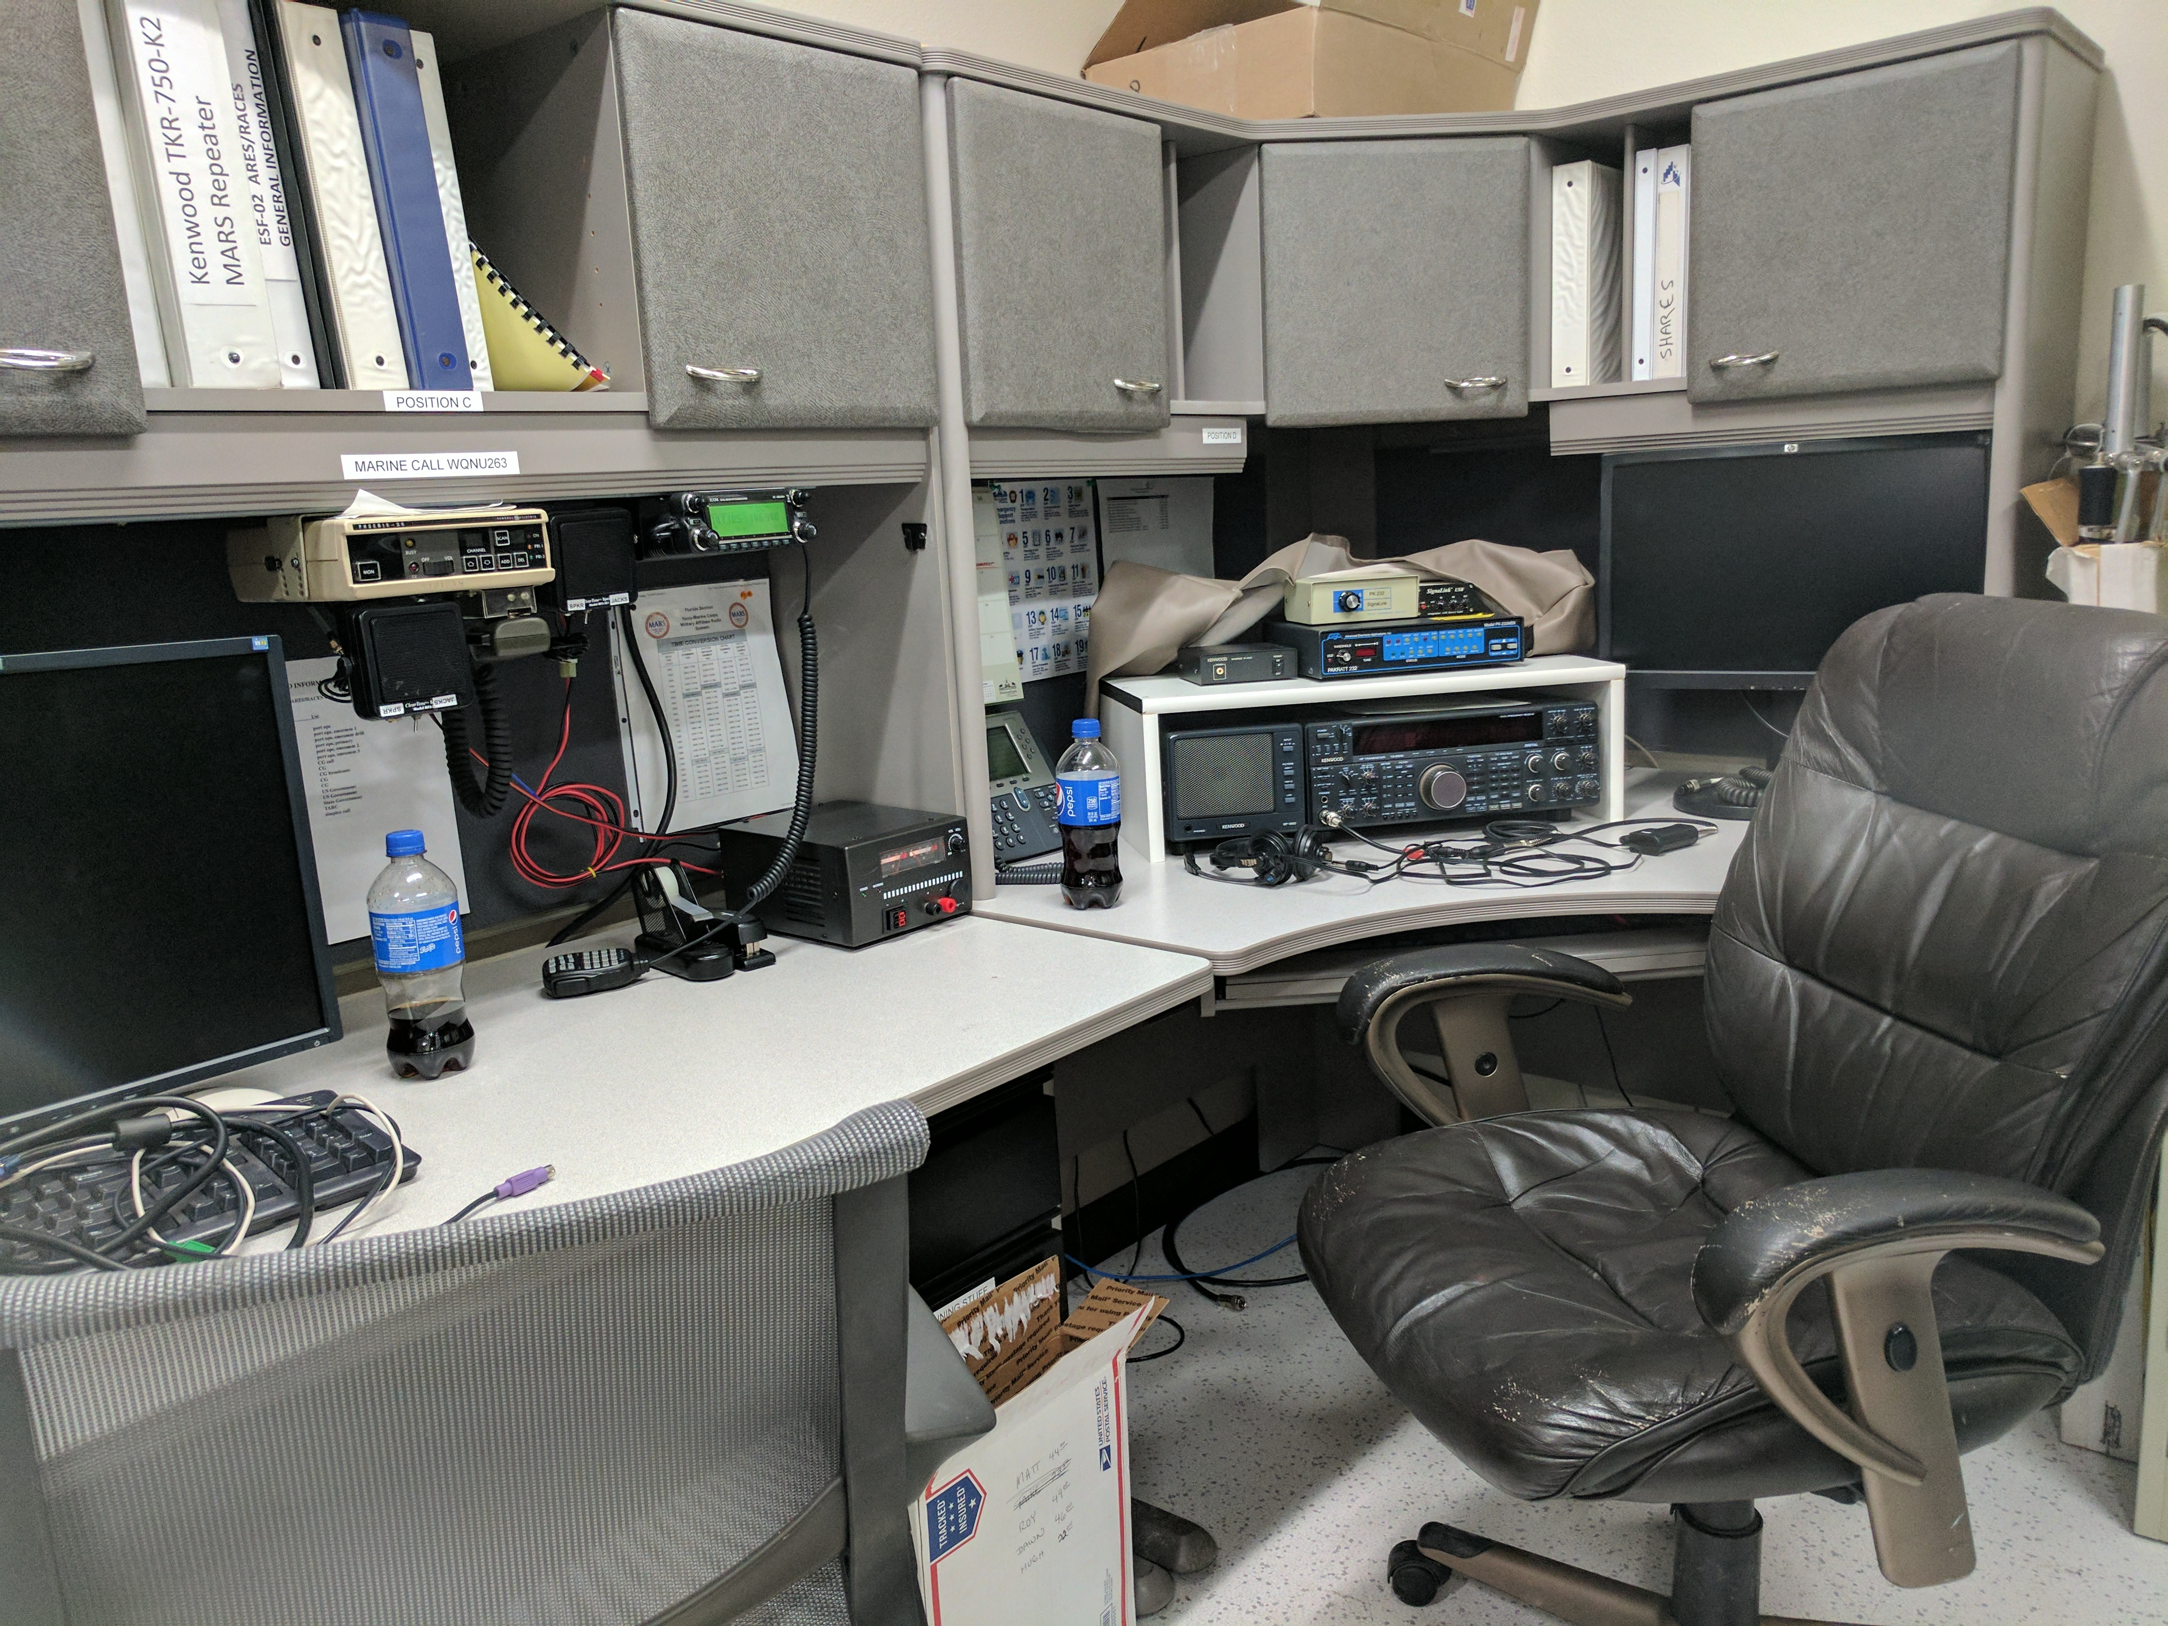
The EOC and ARES/RACES
In Hillsborough County both ARES and RACES are combined under the authority of a combined Emergency Coordinator and RACES Officer who is Jon Rubin, KJ4NYD.
Amateurs can register at http://aresdb.com (userid/pass)
ARES/RACES has amateur radio equipment in PSOC Room #206.
ARES/RACES sponsors:
Amateur Radio Licensing Classes
Skywarn Training
Monthly Simplex Net
”Get-to-Know-Your-Radio” night
Tampa MS Walk
MS Citrus Tour

Slide 11
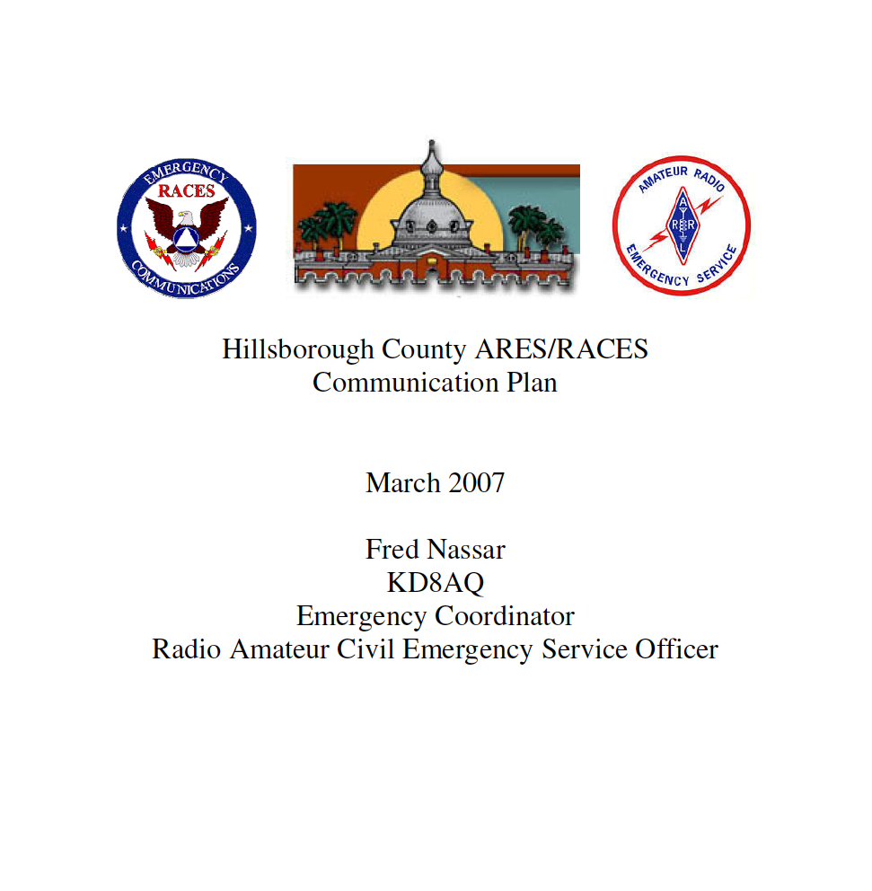
The EOC and ARES/RACES
ARES/RACES Operates with a Communications Plan.
Identifies:
Responsibilities
Concept of Operation
Training
”Home Training” Classes from FEMA for Volunteers:
IS-100.b
IS-200.b
IS-700.b
IS-800.b
National Incident Management System (NIMS): https://training.fema.gov/nims

Slide 12
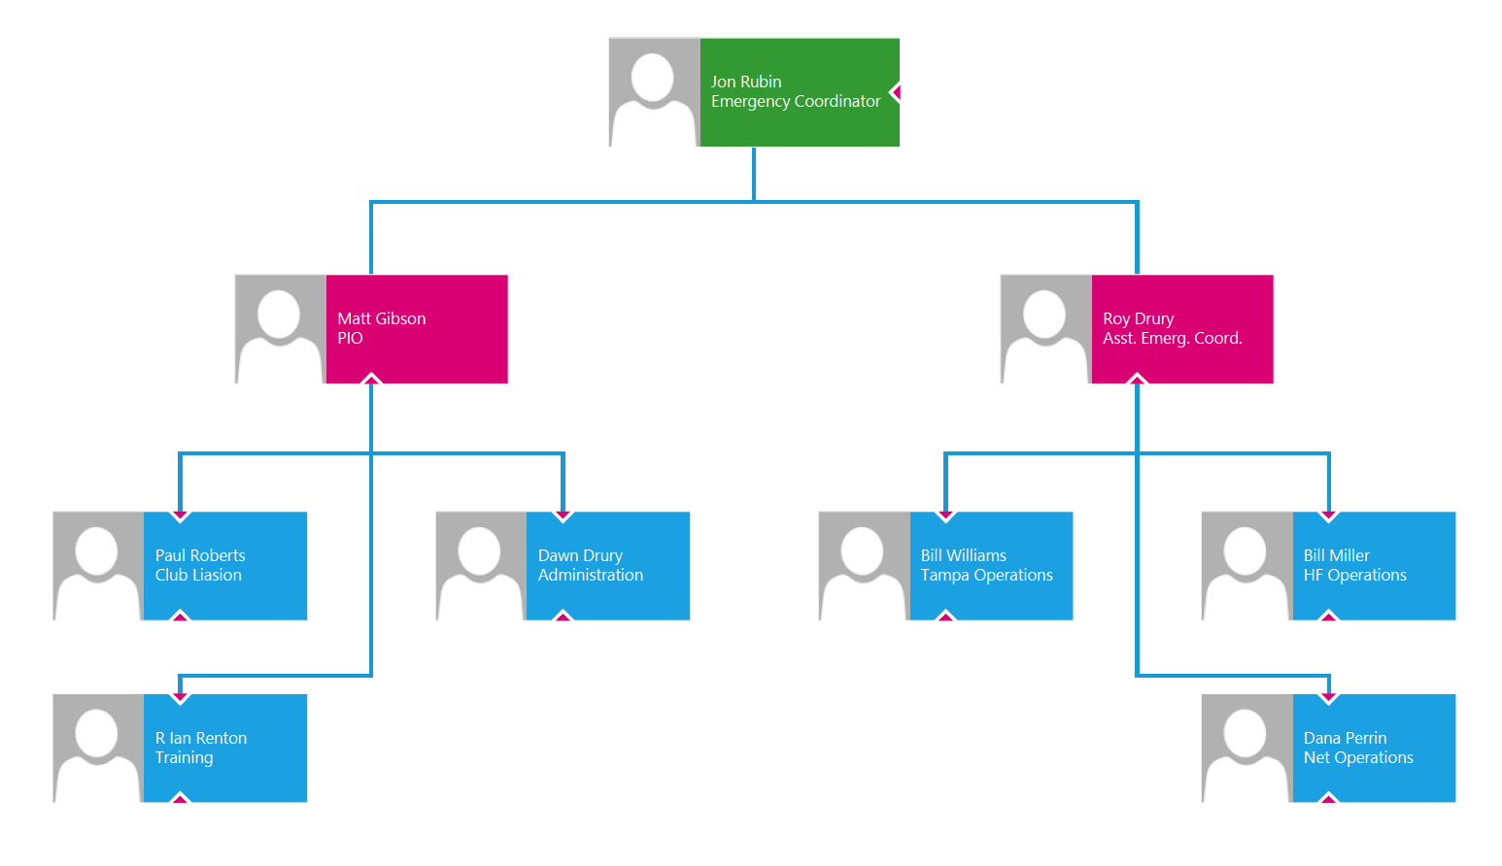
The EOC and ARES/RACES
ARES/RACES Organization Chart includes several positions:
Ass’t Emergency Coordinator
Public Information Officer
Administration
Club Liaison
Training
Tampa Operations
HF Operations
Net Operations

Slide 13
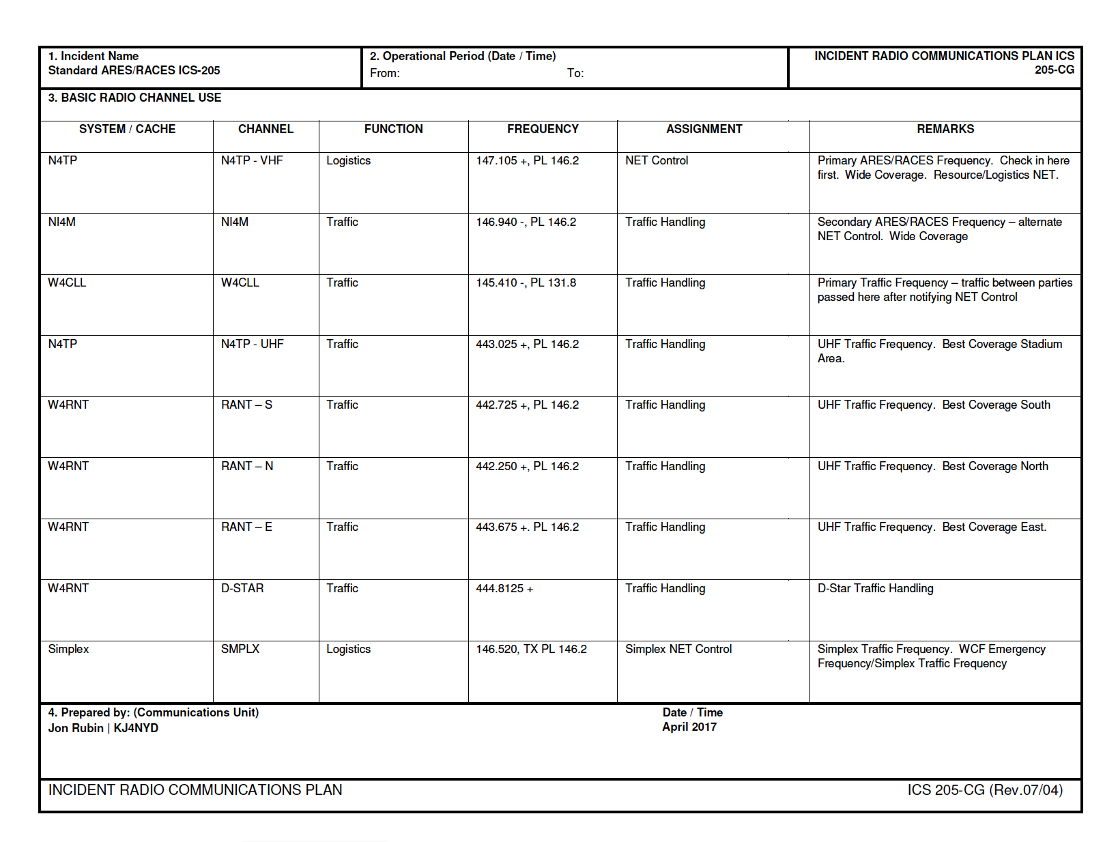
The EOC and ARES/RACES
An important document is the ICS-205, the INCIDENT RADIO COMMUNICATIONS PLAN. Coming soon – NEW plan
It identifies the frequencies and anticipated assignments for various repeaters and channels.
One very important repeater frequency is 147.105 + PL 146.2 which is the Tampa Amateur Radio Club (TARC) repeater. Have B/U.
It is the Primary ARES/RACES frequency and would be the control station for the county Resource & Logistics NET. New call: N4HCA

Slide 14
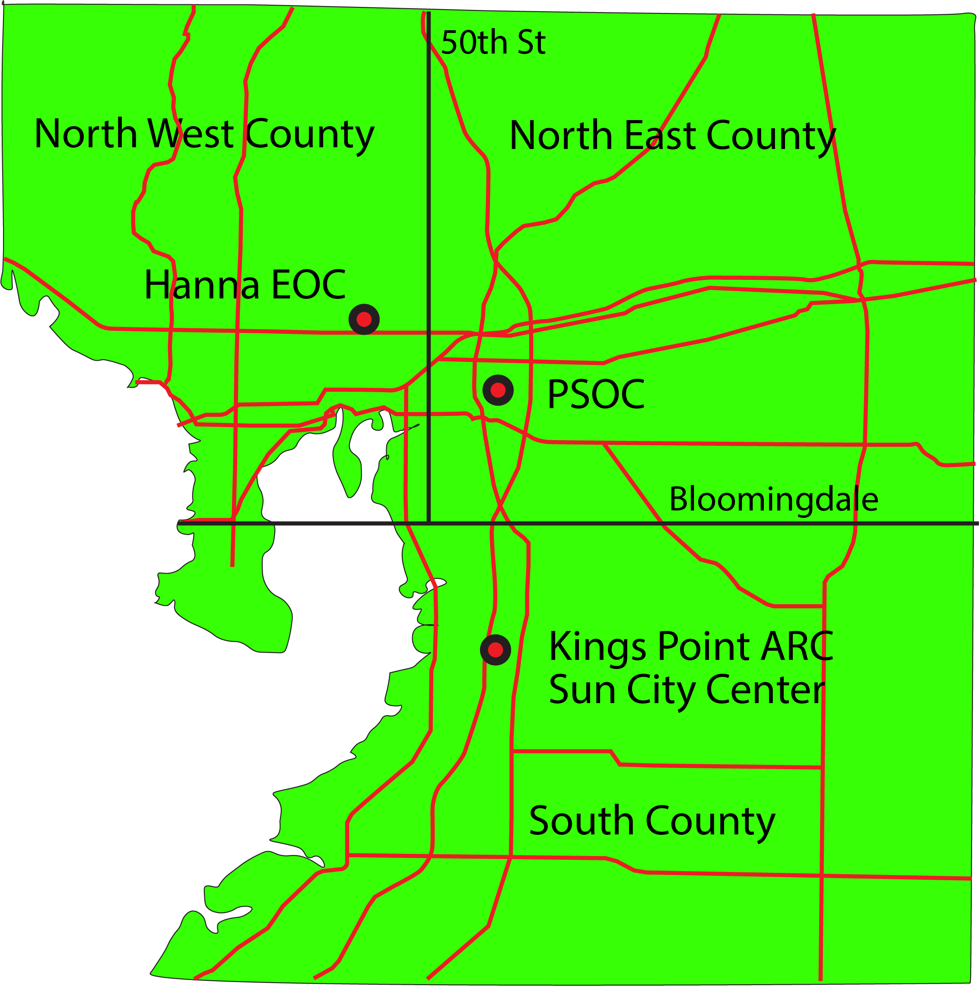
Concept of NET Operations
• NEW County divided into 3 Sections
North West County
Net Control located at the Hanna “EOC.”
Tampa ARC will staff this location.
Will pass traffic to PSOC.
South County
Net Control located at the Kings Point ARC in Sun City Center.
Will pass traffic to PSOC.
North East County -BRH
Net Control located at the PSOC.
• NEW Separate ICS-205s will be developed for each Section as well as an overall ICS-205.

Slide 15
Message Handling
There are basically two type of messages: 1. Informal and 2. Formal.
Informal:
Simple inquiry or report requiring only a brief exchange.
Example: “Is commercial electric power currently available at the Brandon Hospital”
Verbal Response: “Affirmative, there is commercial electric power available.”
Formal:
More complicated exchange in which errors might create problems or delays.
Example: “Brandon Hospital requires assistance in the following three areas…”
Written copies of the messages are desirable for both the sender and receiver.
To make sure the originating communicator clearly understands the request with correct spellings. If possible, the originator should review the written message.
To make sure the receiving communicator has transcribed the message correctly.
To provide accurate documentation for communicators operating different shifts.
d) The appropriate general message form is the ICS-213

Slide 16
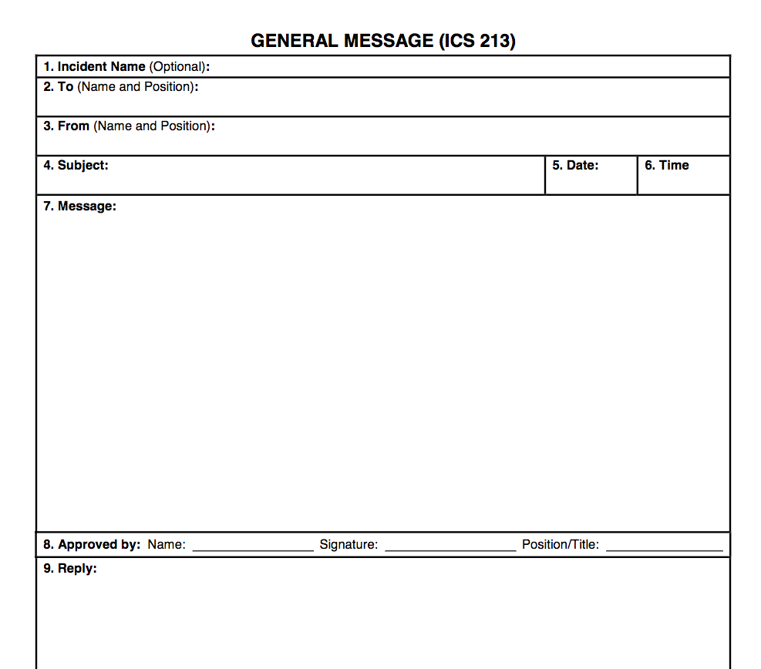
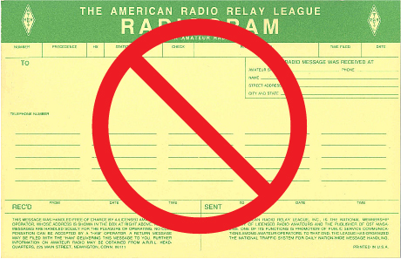
ICS-213
Note: The ARRL National Traffic System RADIOGRAM should not be used within the Incident Command System.

Slide 17
NET Protocol
Listen before transmitting to prevent interference.
Plain English should be used. No Ham Radio jargon such as QSL, QTH, or QRZ should be used.
Tactical Callsigns should be used to:
Reduce confusion
Enhance the efficiency and efficacy of emergency operations.
Increase communication consistency over many operating shifts and different operators
To comply with FCC requirements, append your amateur radio callsign at the end of you last transmission or after 10-minutes of elapsed time.
Tactical Callsigns can be assigned by NET control or self-assigned.
Example: “This is Brandon Regional Hospital, go ahead.”

Slide 18
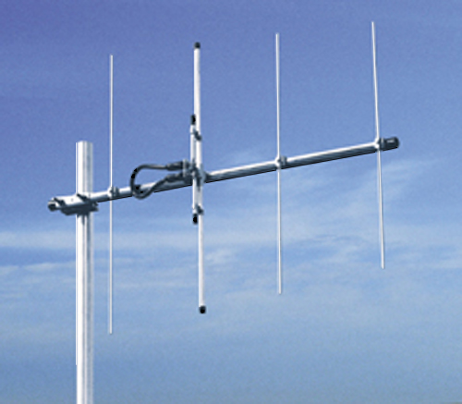
Brandon Regional Hospital
The Hospital has one Yaesu FT-8800R VHF/UHF transceiver at the Brandon Hospital. There is a vertically polarized yagi pointed at Tampa permanently installed on a tower in the general area of the Heliport.
Yaesu FT-8800R VHF/UHF Transceiver VHF/UHF Yagi

Slide 19
Brandon Regional Hospital
The radio is stored in a bright yellow Pelican case kept by our liaison, Rich Walker, Director of Security & Safety Services. Rich’s office is off the Emergency Room waiting area. His office telephone number is 813-916-0477, but the security staff should be able to contact him. A backup contact is Bill Trombley., Safety Services Manager
Our operating location is in the Staff Lounge of the Radiology Department. This is a shared space, so we must be understanding with the Hospital Radiology staff.
The end of the “hardline” transmission line is located on top of the acoustic ceiling tiles above the staff lockers. Help from Rich Walker may be required to access the transmission line.

Slide 20
Brandon Regional Hospital
Another Yaesu FT-8800R VHF/UHF transceiver is located in the Free-Standing Emergency Room at 3065 James L. Redman Pkwy, Plant City, FL. The antenna is a vertically polarized yagi pointed towards Tampa.
The operating position is located in a “mechanical” room at the southwest corner of the building. The coaxial cable transmission line is co-located with the radio, by it is probably necessary to connect the PL-259 connector to the radio.
The room door will be locked and assistance from the Emergency Room security staff will be necessary.
Both transceivers are accompanied by a RED 3-ring binder with spare forms and simple instructions for operating the radios.
Note: The Plant City Emergency Room does not have any facilities for housing or feeding volunteers.

Slide 21
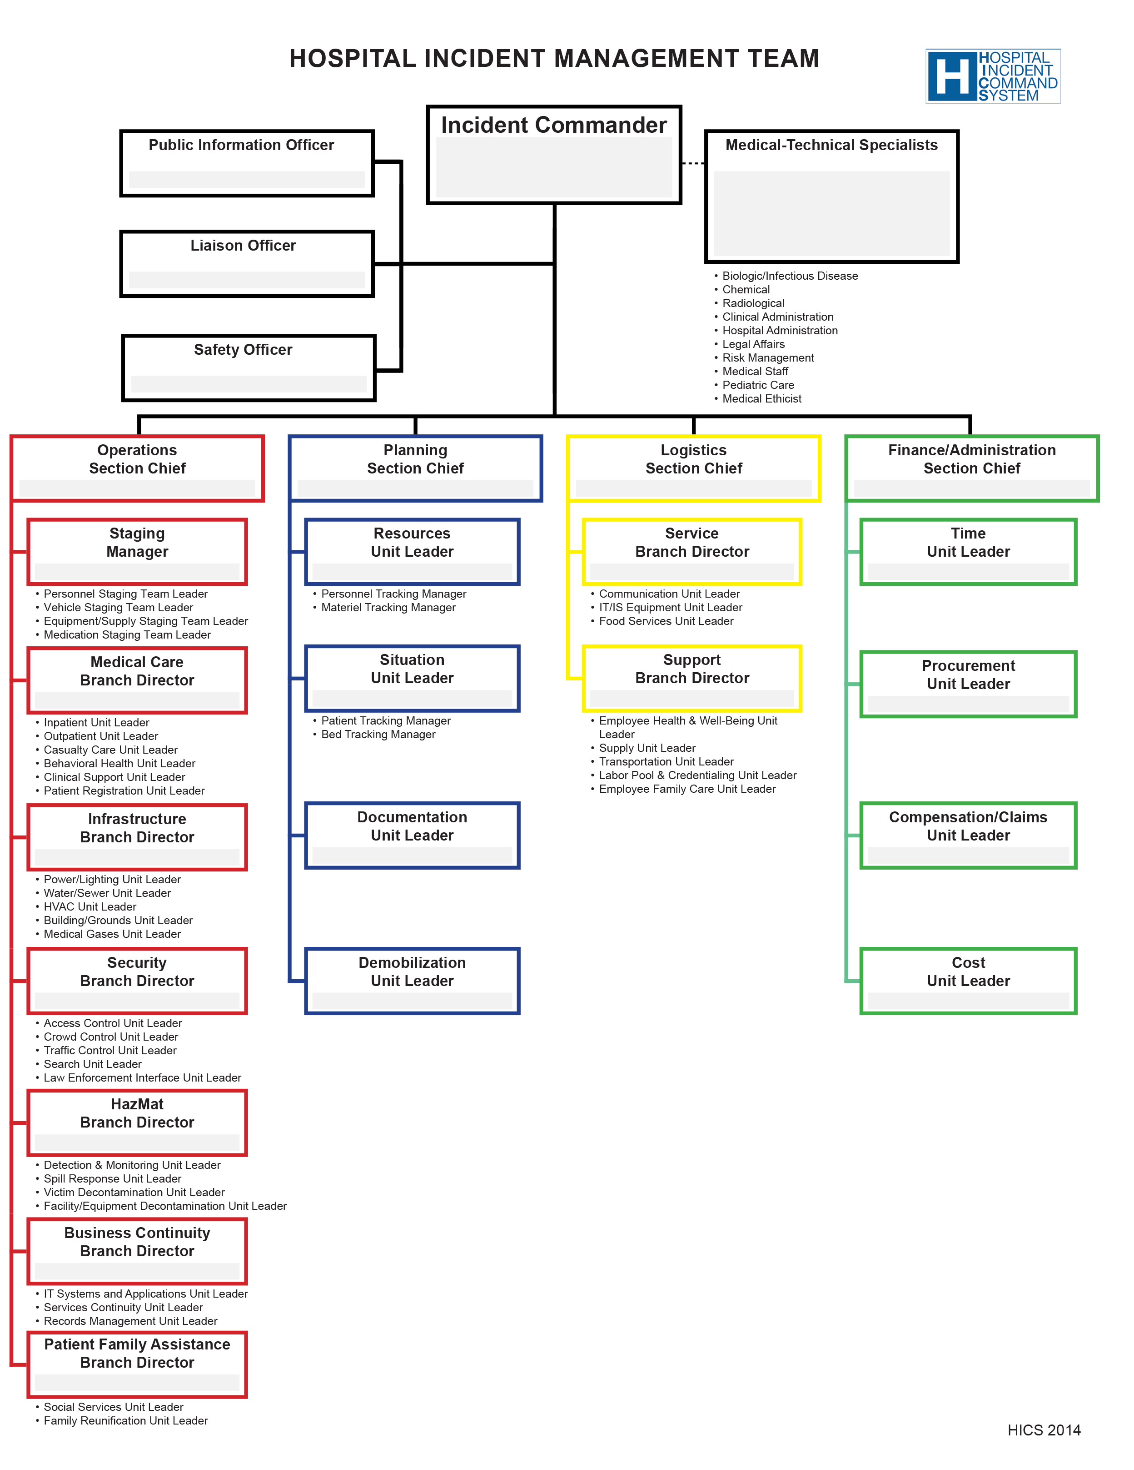
Brandon Regional Hospital
In emergencies the Hospital uses the Hospital Incident Command System (HICS)
This is a variation of the ICS adapted to the needs of a hospital, but both are quite similar.
Hospital staff will be wearing vests indicating their role in the Incident Management Team.
The Incident Command Center may be in a nearby hallway adjacent to a nursing station. Consult with Rich Walker, our liaison, for directions.

Slide 22
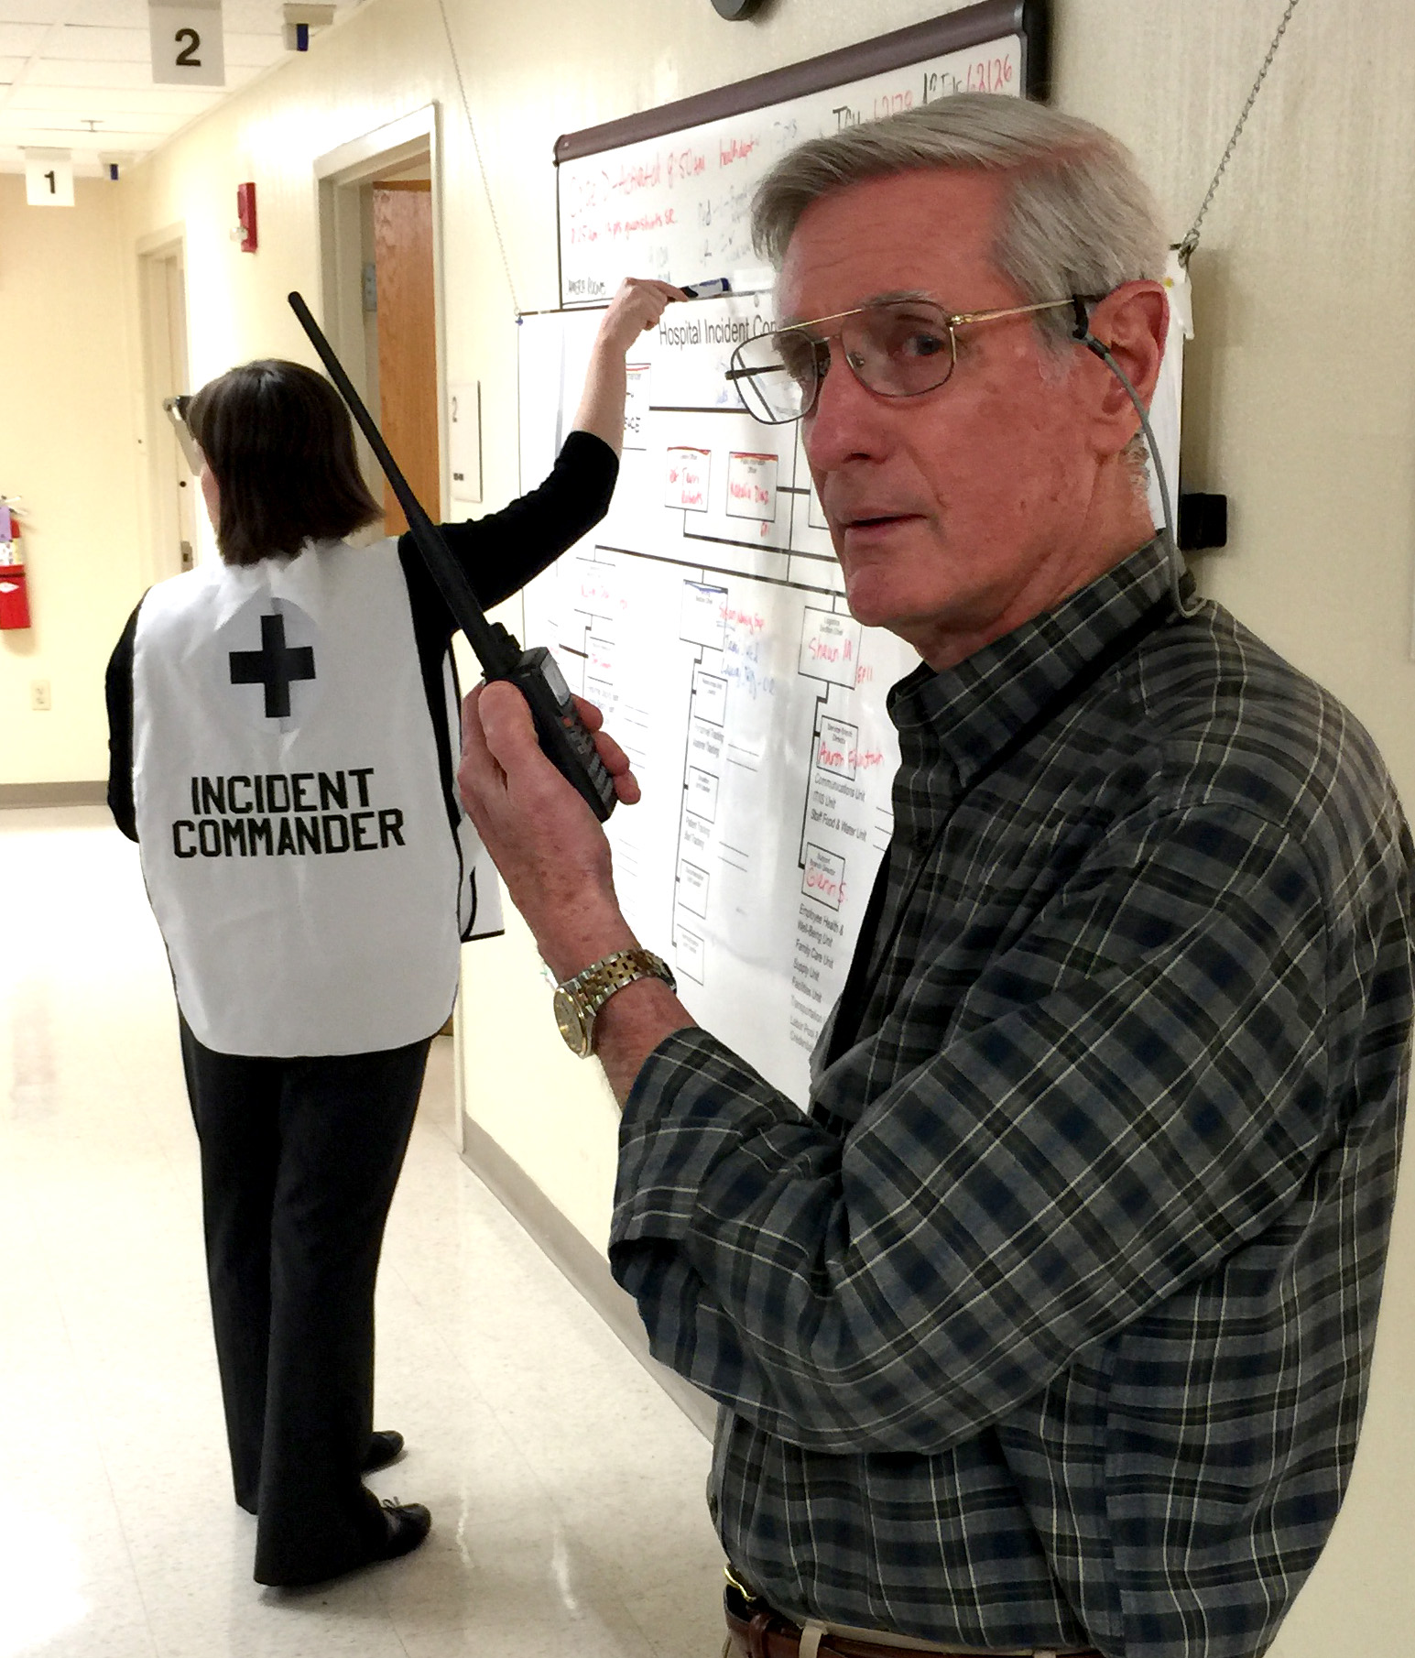
Brandon Regional Hospital
After setting up the transceiver in the Radiology Staff Lounge, one of the volunteer Communication Operators should introduce themselves to the either the Incident Commander (or Liaison Officer – depending on the situation) and report our operating status and location.
Periodic visits to the HICS management position are in order to maintain some operational awareness of the emergency.
Hospital Security Staff may loan one of their UHF radios to the Amateur Radio Communication Operators to help with internal Hospital operations.

Slide 23
Brandon Regional Hospital
Although we consider Amateur Radio emergency communications to be an affiliate of the Hillsborough ARES/RACES, we should take our direction from the Hospital Incident Management Team.
Although our MOU says that volunteer Emergency Communicators should not be assigned other than communications tasks, one should take into account your own physical abilities and interests in helping if other needs arise during the Emergency.

Slide 24
Brandon Regional Hospital
If the emergency situation disables the external yagi antenna, all the experience of Amateur Radio operators in setting up temporary radios and antennas may be required to help the hospital.
Some possibilities would be setting up temporary operating positions near external doors to locate outside antennas and generators. It could be necessary to contact other BARS members to assemble temporary equipment.
The use of automobile-based mobile radios is another temporary solution…perhaps parked at the top of the hospital parking garages with Handi-Talkie links to positions within the Hospital building.
UHF Simplex frequencies, i.e. 446.0, seem better than VHF frequencies within the Hospital building itself.

Slide 25
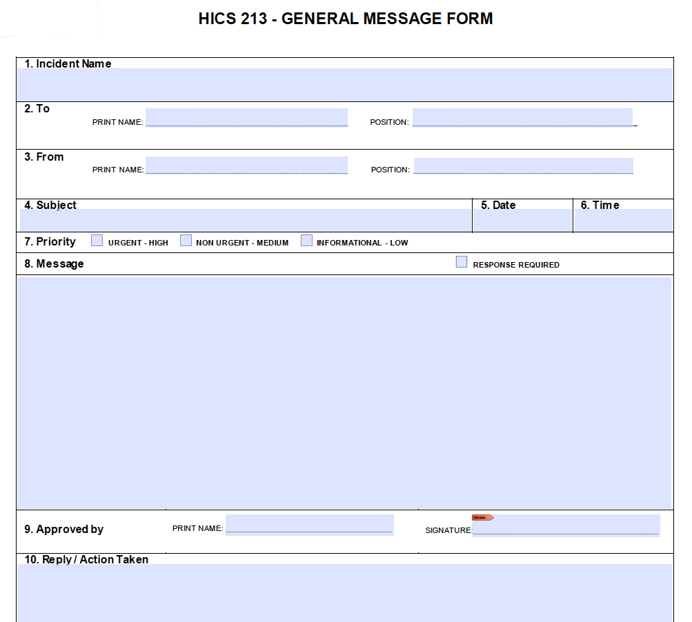
Brandon Regional Hospital
The HICS Management System has their own forms, and a HICS-213 may be more appropriate than an ICS-213 for ”Formal Messages.”
If a member of the Hospital Incident Management System comes to you and asks to send a message, assume it should be a “Formal Message.” Ask the originator to write out the message. It may contain technical terms, and it is good to “capture” an accurate request.

Slide 26
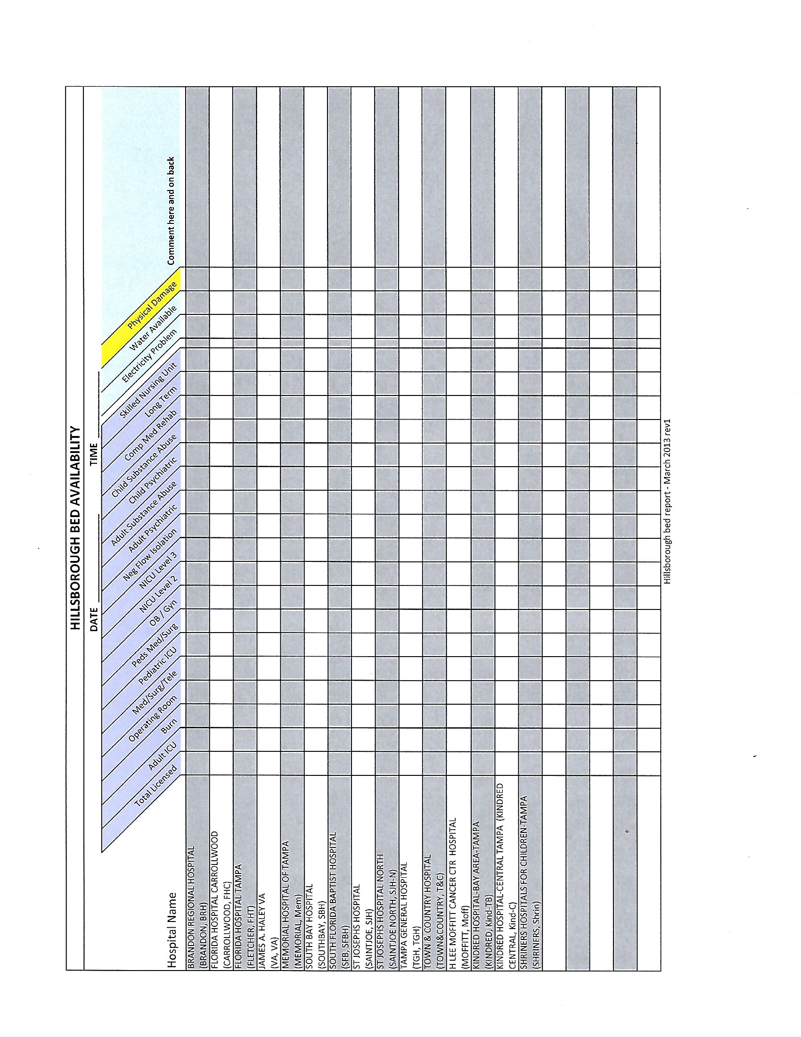
Brandon Regional Hospital

Slide 27
Brandon Regional Hospital

Slide 28
Brandon Regional Hospital

Slide 29
Brandon Regional Hospital

Slide 30
Brandon Regional Hospital

Slide 31
Brandon Regional Hospital
HIPPA, the Health Insurance Portability and Accountability Act, represents an element in Emergency Communications for Hospitals that is unlikely in other deployment situations.
Although culpability for volunteer Emergency Communicators is extremely unlikely since Amateur Radio operator are not under contract for handling patient information, it should be remembered than such information is private and should not be divulged without appropriate authorization.
If a HICS Emergency Management Team member asks to transmit a message with identifiable patient information, it would be appropriate to question it given HIPPA restrictions. If the Hospital Team Member approves it to be sent then you should follow their instructions.

Slide 32
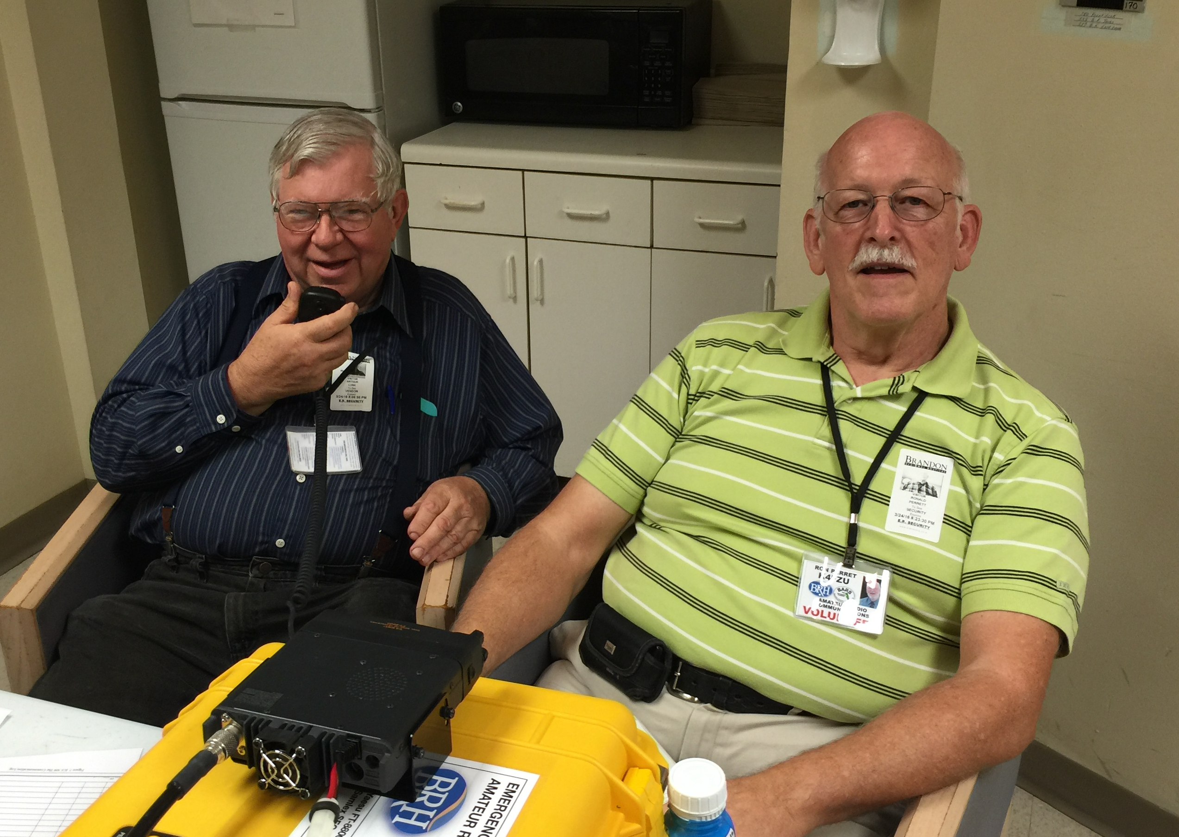
Brandon Regional Hospital
Operation during drills has shown it is a challenge to monitor radio traffic (sometime running on two frequencies simultaneously) and maintain logs. So it is definitely helpful to have at least two operators available.
One operator can also move around the facility for situational awareness and periodic check-ins with the Hospital Incident Management Team.

Slide 33
Brandon Regional Hospital
During Hurricane Irma, the Hospital offered housing and meals for Amateur Radio volunteers (and family members).
Jim Moorehead, WF4AC, and Dana Perrin, KM4DTJ, set up the transceiver in the Radiology Staff Lounge for immediate activation, but given the nature of the Emergency, no volunteer Emergency Communicators were deployed. Hospital staff was confined to the facility for 72 hours.
Jim and Dana reported to the Incident Management Team at the end of the 72-hour period, and dismantled the radio equipment. Attended after-action meeting (“hot-wash”).
The next Drill for BARS/Brandon Regional Hospital is the annual Hillsborough County Mass Casualty Exercise scheduled for Thursday, June 7, 2018 (Maybe?). It usually runs from approximately 8:00 AM to 11:30 AM. Come join us!

Slide 34
Brandon Regional Hospital
Finally, the ”Points of Communication” between BARS and the Brandon Regional Hospital are currently:
Brandon Regional Hospital BARS
Rich Walker
Director Security & Safety Services
119 Oakfield Drive
Brandon, FL 33511
Office: 813-916-0477
Richard.walker6@hcahealthcare.com
Bernie Huth, W4BGH
813-447-9907 (C)
813-684-2989 (H)
berniehuth@Verizon.net
Jim Moorhead, WF4AC
813-468-5570 (C)
813-684-2808 (H)
wf4ac@tampabay.rr.com

Slide 35
Brandon Regional Hospital
Finally, the ”Points of Communication” between BARS and the Brandon Regional Hospital are currently:
Brandon Regional Hospital BARS
Rich Walker
Director Security & Safety Services
119 Oakfield Drive
Brandon, FL 33511
Office: 813-916-0477
Richard.walker6@hcahealthcare.com
Bernie Huth, W4BGH
813-447-9907 (C)
813-684-2989 (H)
berniehuth@Verizon.net
Jim Moorhead, WF4AC
813-468-5570 (C)
813-684-2808 (H)
wf4ac@tampabay.rr.com
QUESTIONS?

